Slide 1

ProxMOX - HomeLab
Glenn West – gwest@redhat.com
June 24, 2024

Slide 2
Why the Change
Move to workstation and lab in one.
Pass-thru for good performance of desktop environment is important.
Wanted to increase performance
DDR5
More memory > 128Gig
NVME SSD Disk using PCI-Express 4
Wanted a GUI and CLI

Slide 3
Hardware – Intel LGA1700 Build
ASROCK B760M PG Riptide LGA1700 DDR Micro ATX Motherboard
CORSAIR DDR5 192 Gig (4 x 48Gig)
Crucial P3 Plus 2TB PCIe 4.0 NVMe M.2 (up to 5000MB/s) – CT2000P3PSSD8
Vetroo V360 AIO Cooler
Thermaltake Tower 500 Case
Sapphire 11310-01-20G Pulse AMD Radeon RX600 GPU
Qty 3 – SATA 2TB SATA SSD
Qty 1 – Seagate 8TB

Slide 4
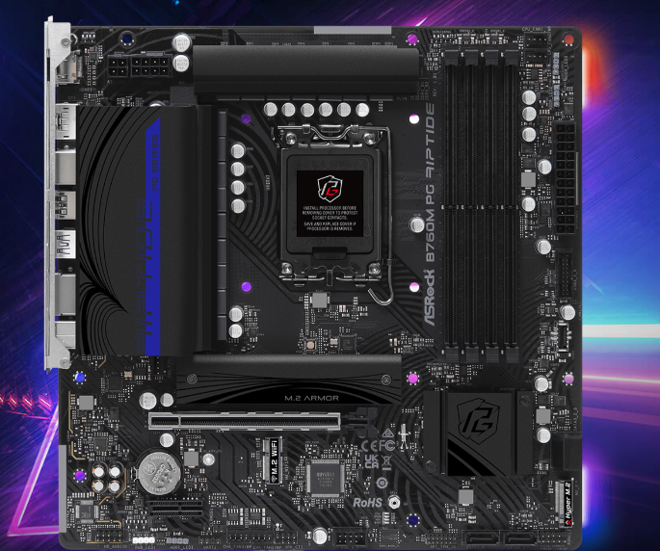
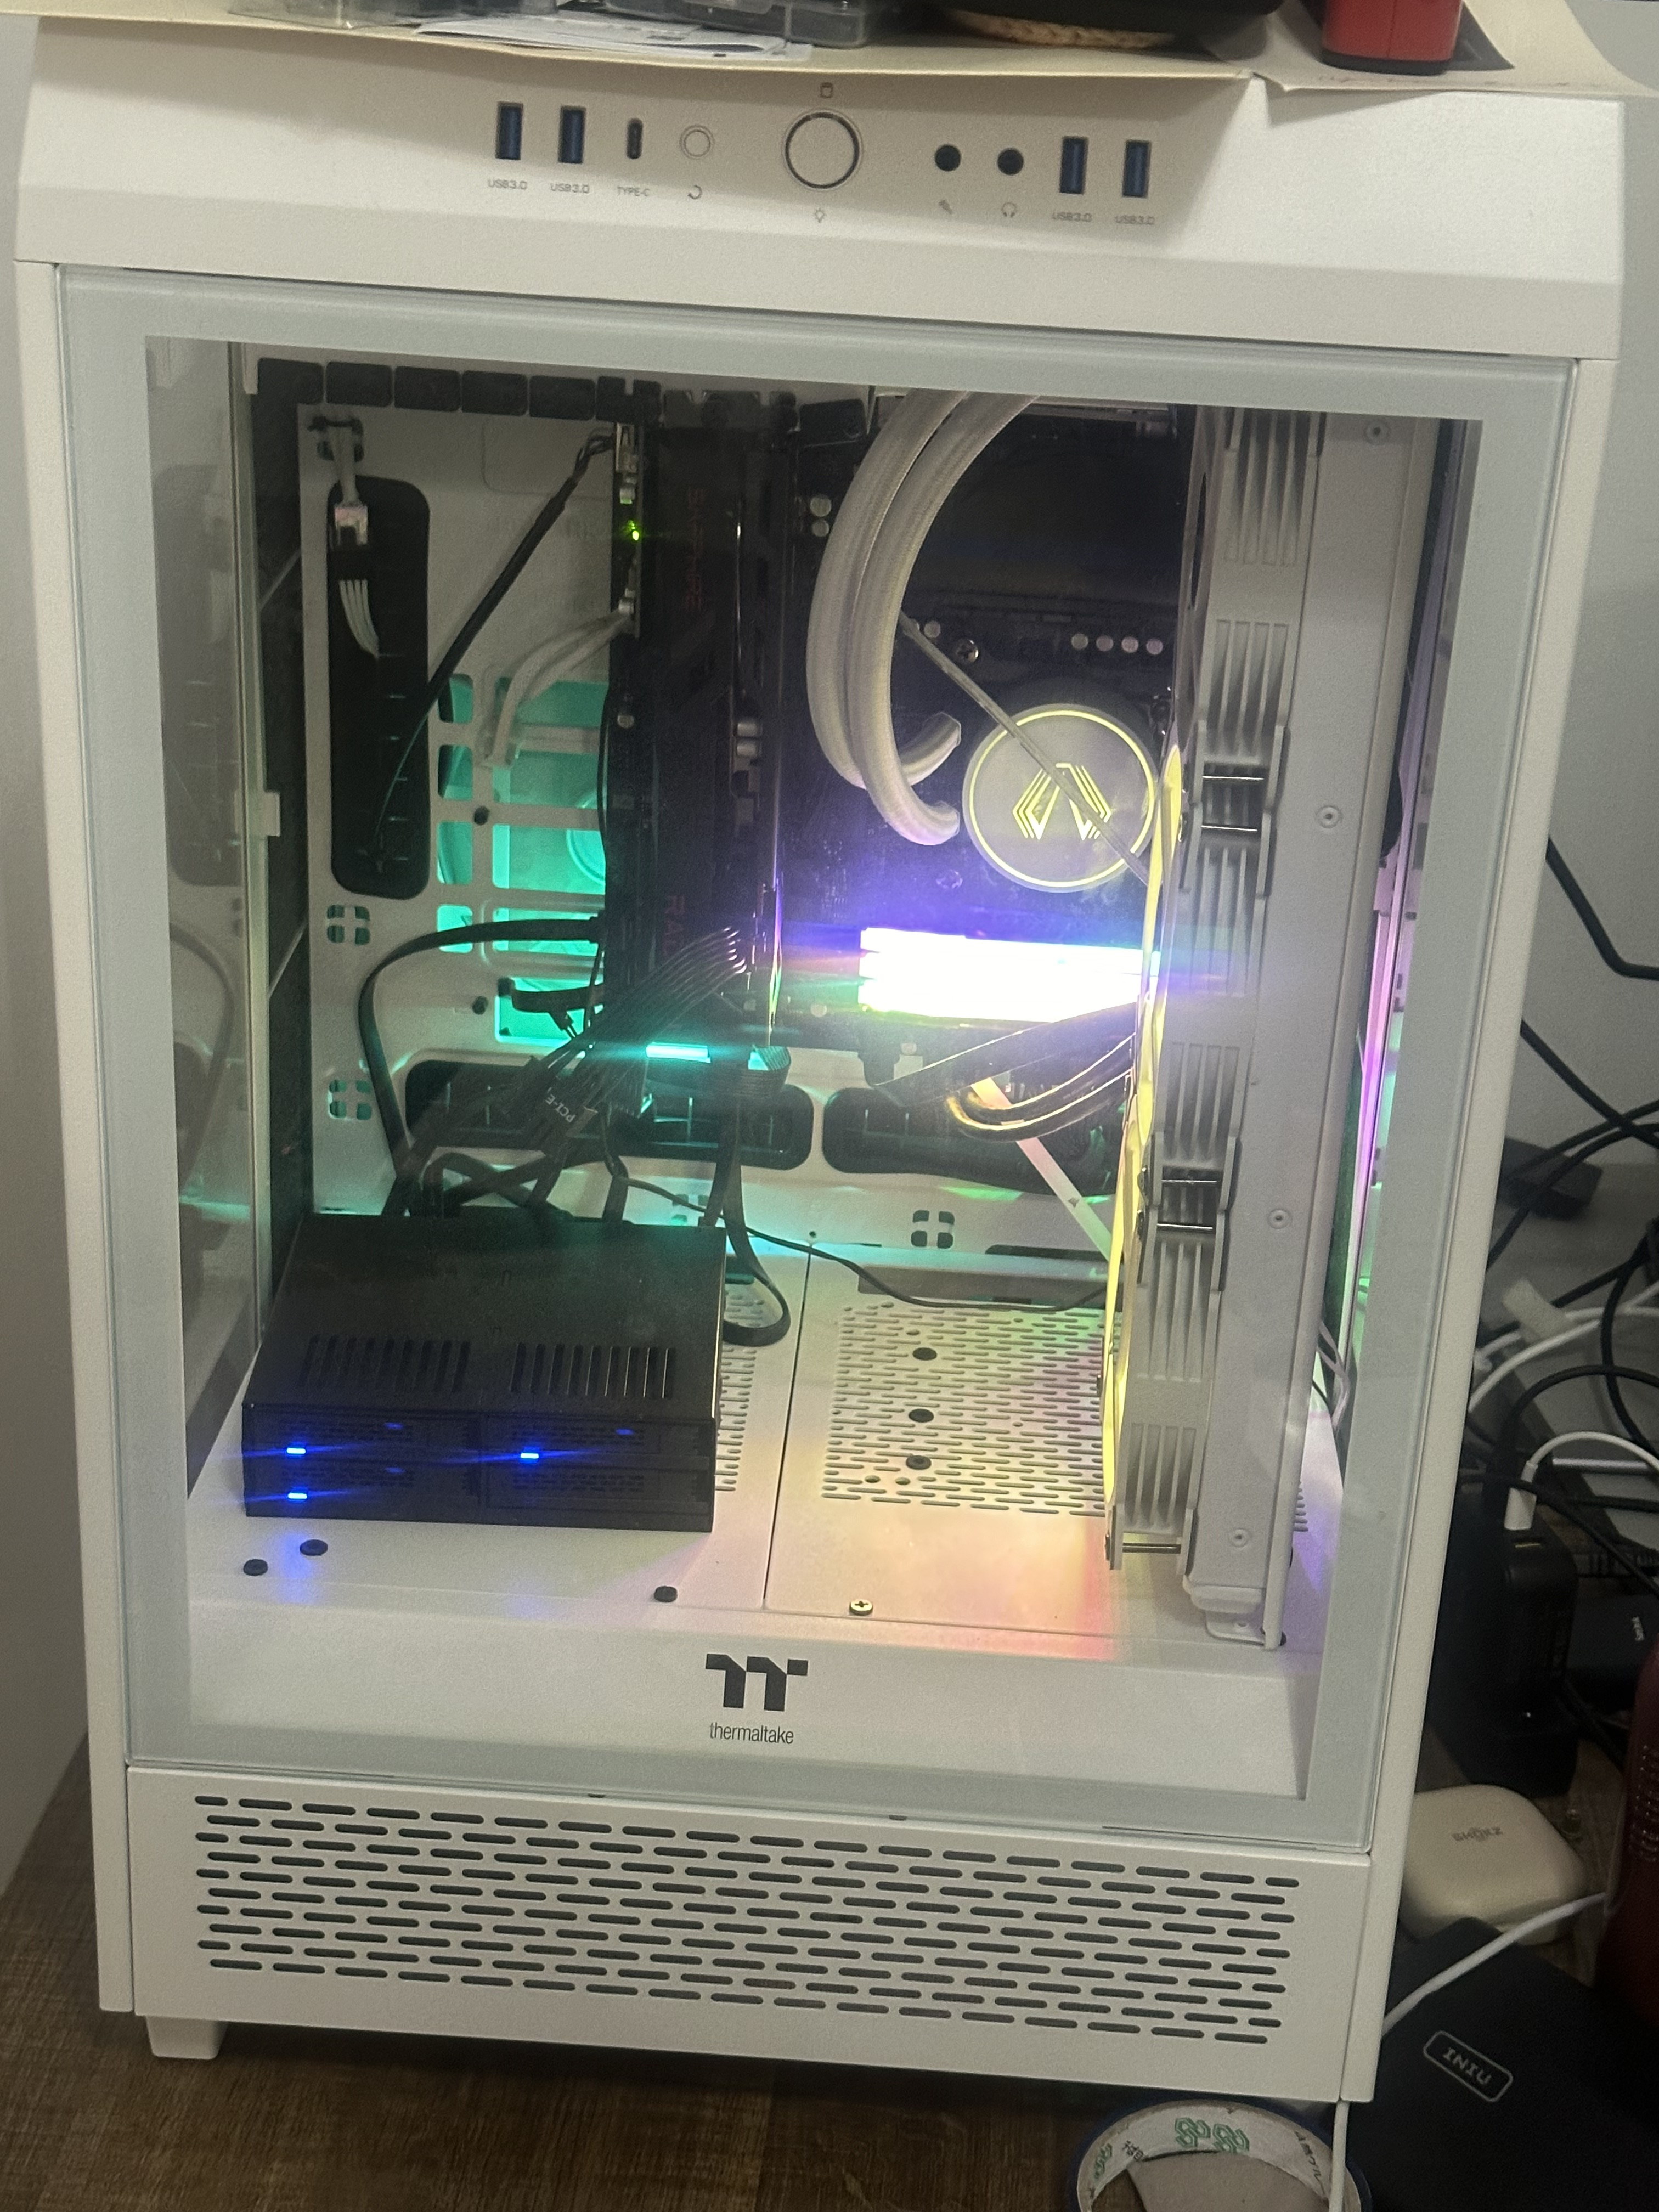
Hardware

Slide 5
Promox Overview
Debian Based
KVM
LXC
Web Based Management Interface
CLI
REST API
Clustering – ETC Mirroring
Online Migration
SDN
Ceph
Backup/Restore

Slide 6
Promox Hints
Proxmox can be installed on slow disk
Reserve NVMe drives for production vm’s (Desktop environment) and Test
Put test vm on separate VM
Minimize / avoid anything on “host” level.
For High Performance:
Pass thru GPU
Fedora/OSX/Windows works great
Pass thru USB
Audio works great
Arduino Works fine
Bluetooth
Use BT-W3X so headset is usb audio

Slide 7
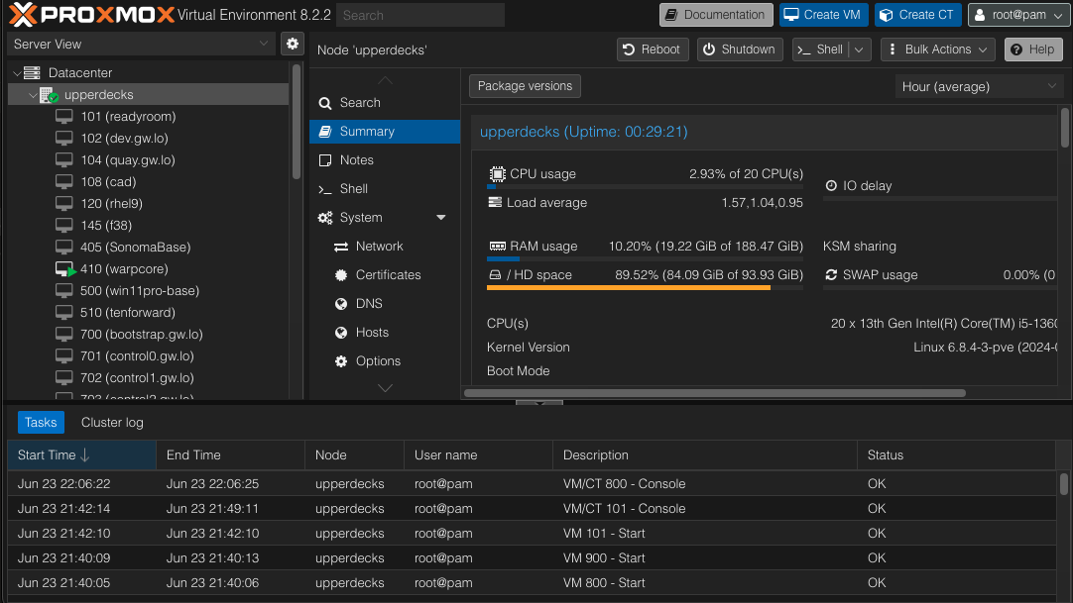
Promox GUI

Slide 8
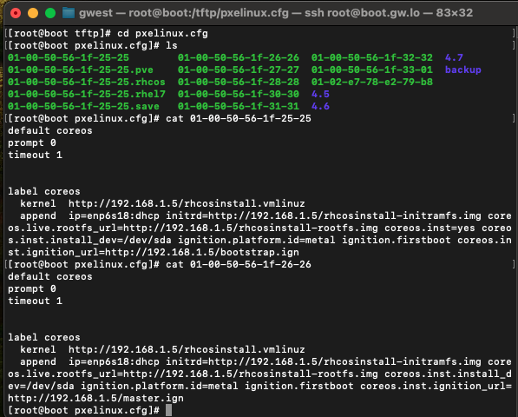
Openshift Test/Install
Bare Metal Install
- PXE Boot
VM - DNS Server
VM - Boot Server - TFTP

Slide 9
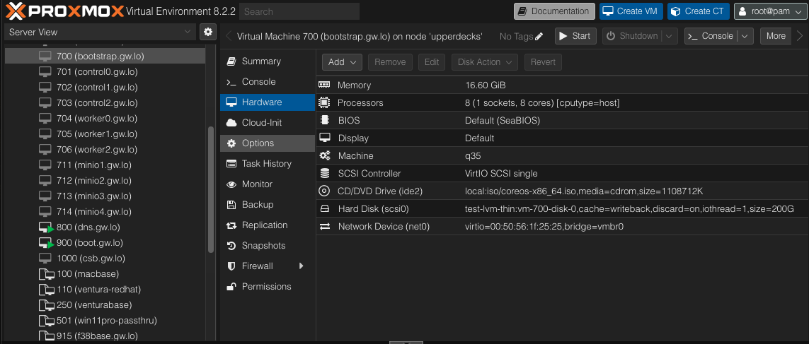
TesT Cluster Config
1 Bootstrap
3 Control
3 Workers

Slide 10
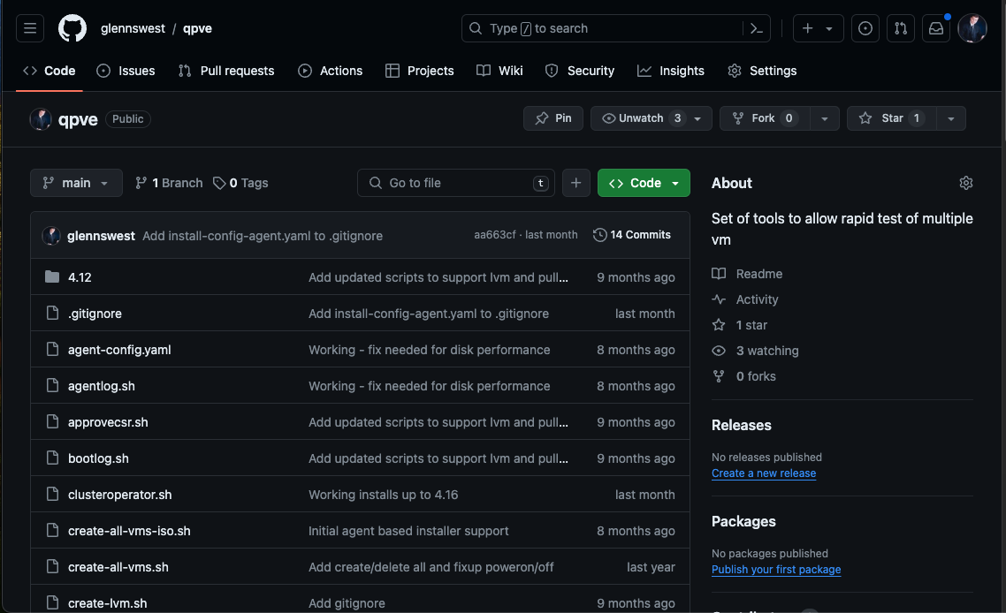
Scripts
Deployments are done via scripts
Scripts are located at:
https://github.com/glennswest/qpve

Slide 11
Top level scripts
./Install.sh x.y.z – Install specified version
./pull-os.sh x.y.z – Pull specified OS and copy to right location
./pull-install.sh x.y.z – Pull openshift installer
./approvecsr.sh – Approve csr
./clusteroperator.sh – Watch Operators During Installs

Slide 12
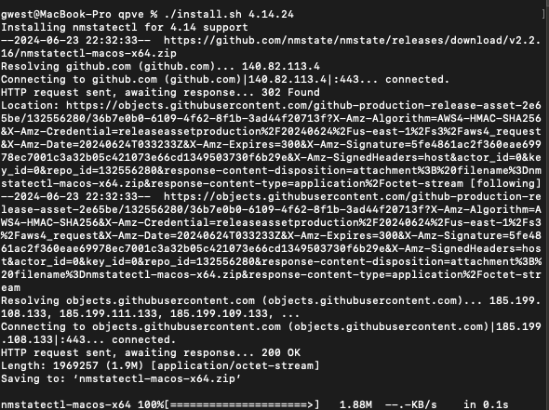

Slide 13
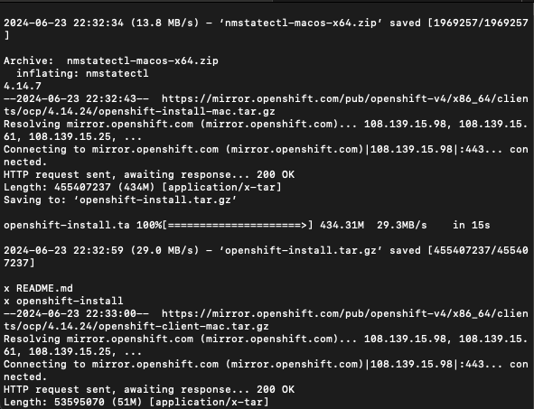

Slide 14
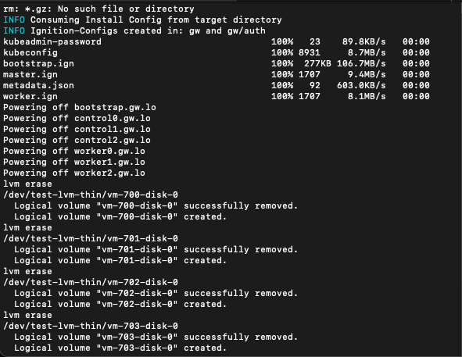

Slide 15
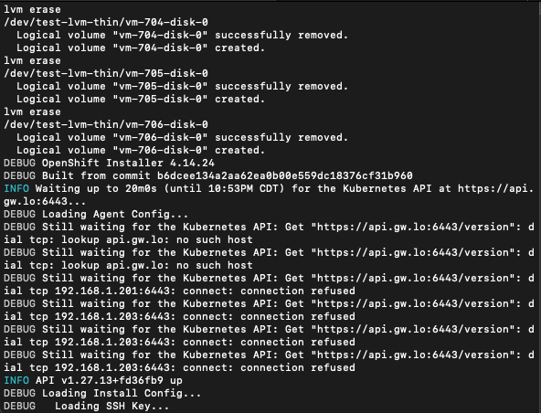

Slide 16
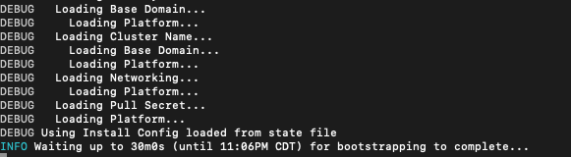
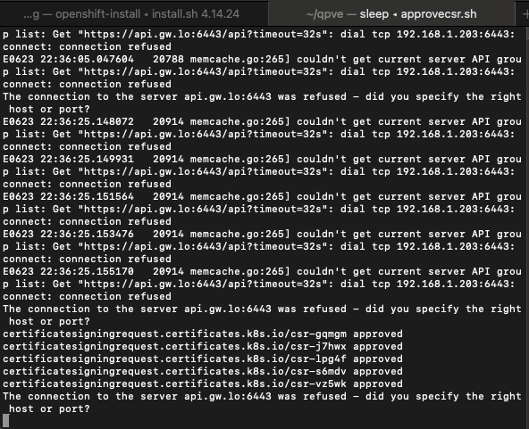

Slide 17
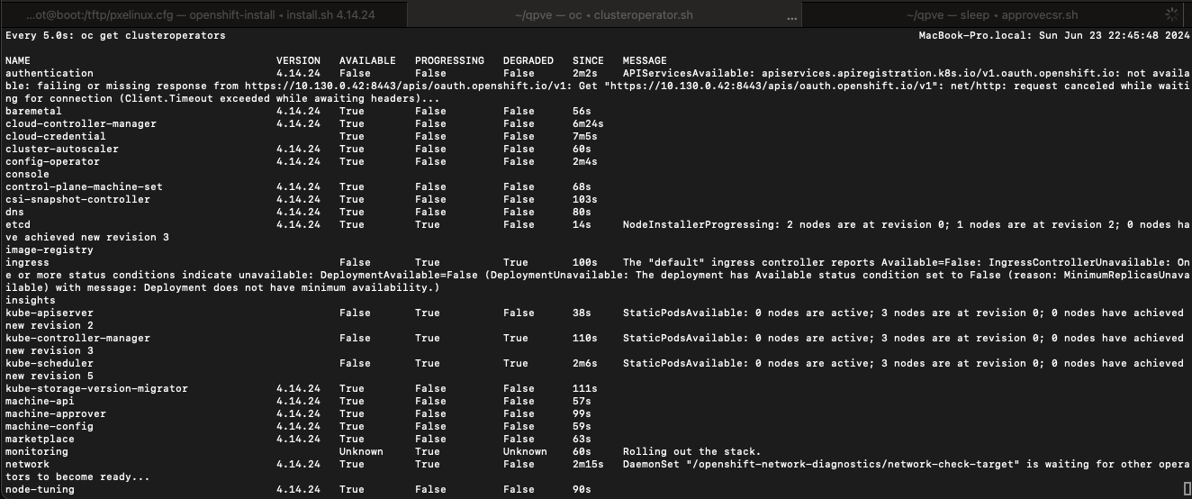

Slide 18
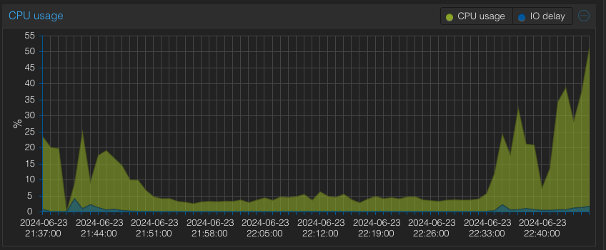
CPU Usage with Bootstrap and 3 Masters

Slide 19
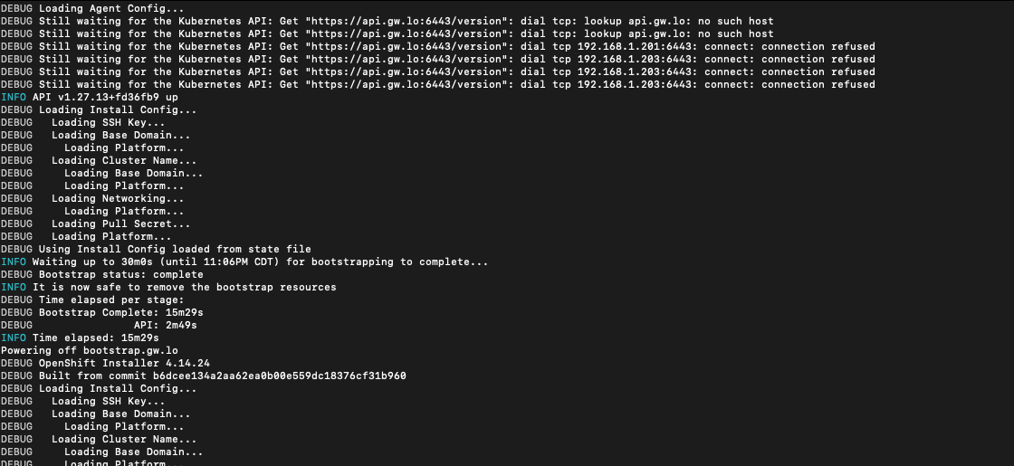

Slide 20
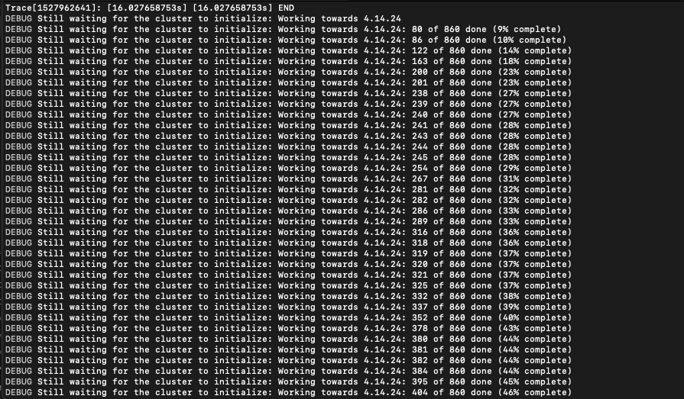

Slide 21
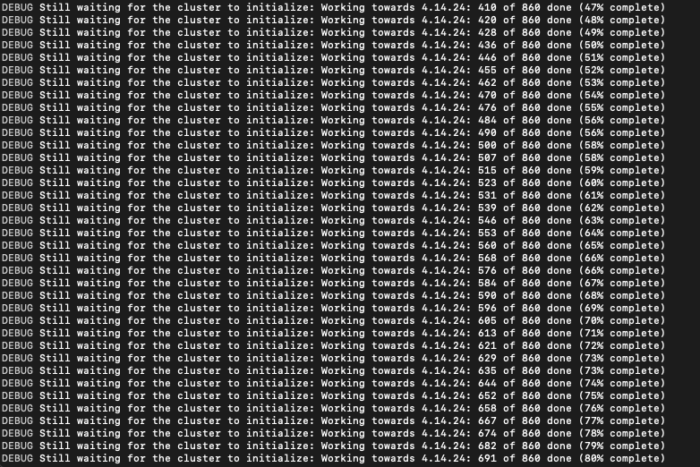

Slide 22
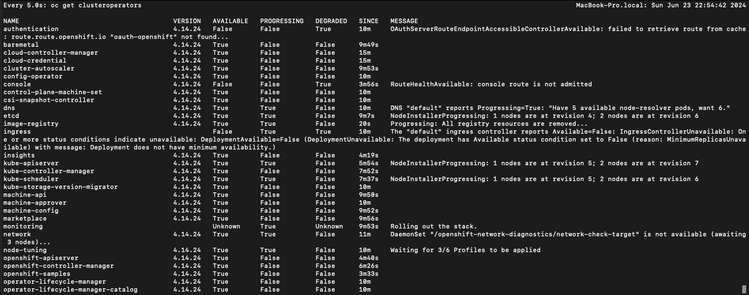

Slide 23
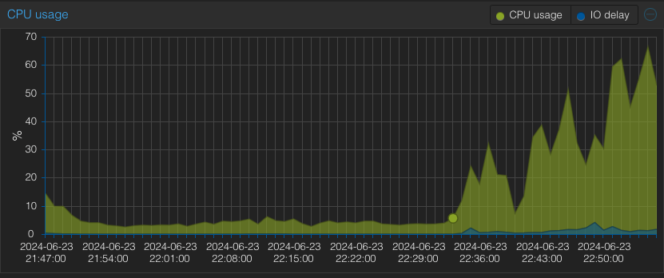
Usage with 3 Control and 3 workers

Slide 24
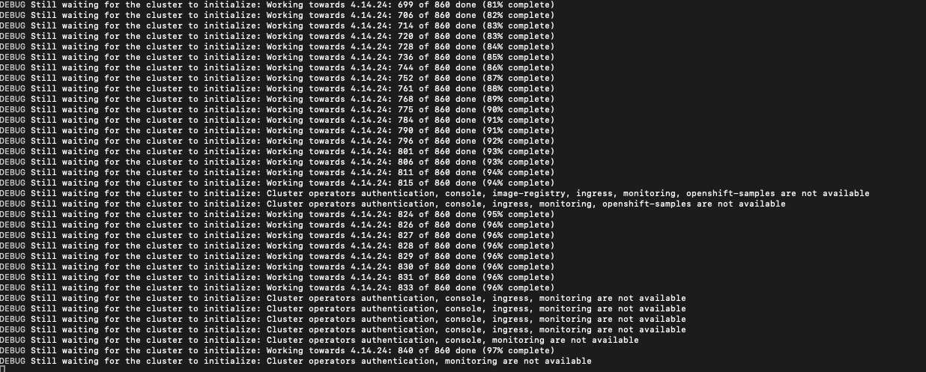

Slide 25
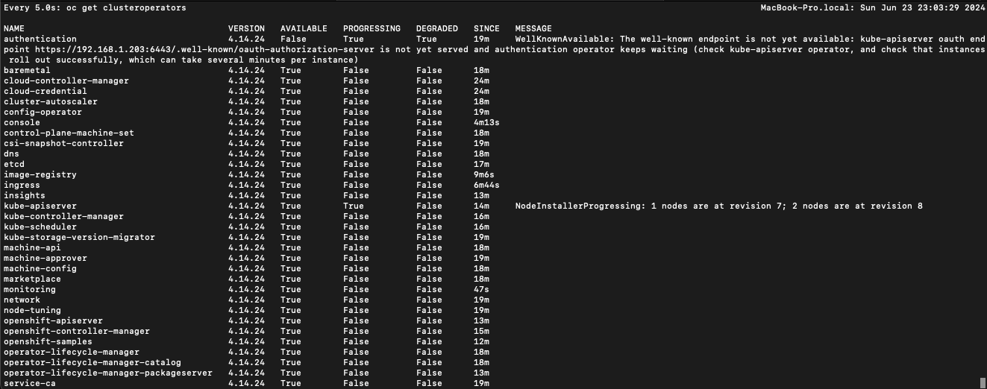

Slide 26
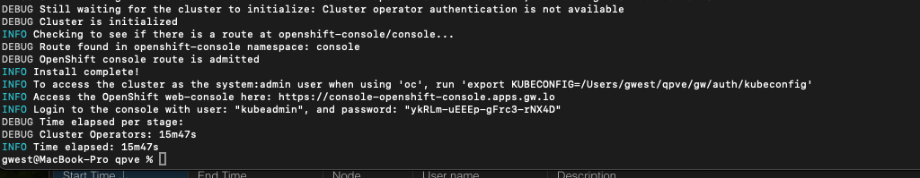
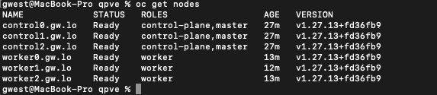

Slide 27
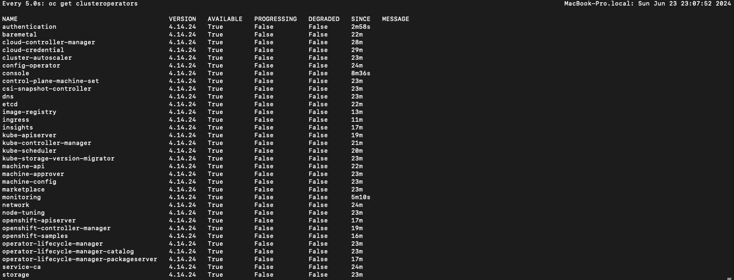

Slide 28
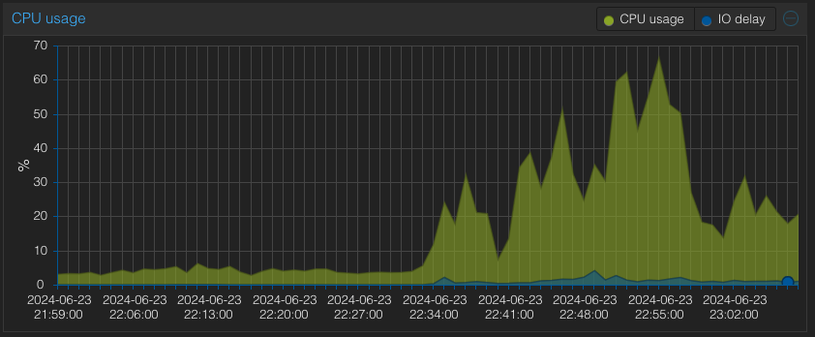
Install Complete CPU Usage

Slide 29
Summary
Repeatable Multi-Node and Single Node Installs
Stable environment for development
Fully mixed environment – Fedora RHEL OSX
Backup with snapshot really helps

